Slide 1
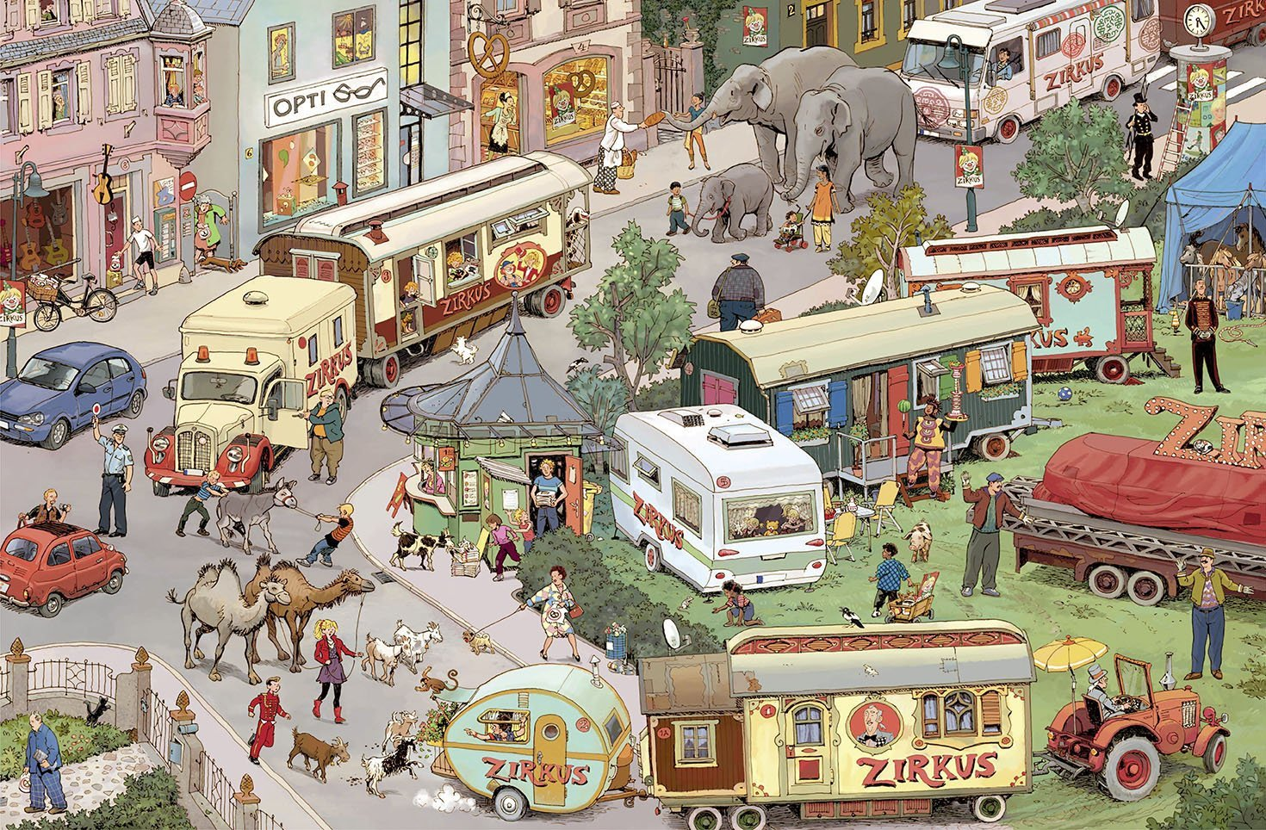
elephants love bread
this is a clown
two camels follow the girl

